Slide 1
The microbiome of Amerindians living in subsistence economies with different exposure to medicine
Jincheng Wang, Dan Scot Kyle Bittinger, Haipeng Sun, Oscar Noya, Monica Contreras, Noel Mueller, Orlana Lander, Mariapia Bevilaqua, , Kyle Bittinger, Maria G Dominguez-Bello
Environmental factors (diet, chemical exposures, infections, human microbiome) are sources of human variation in grown, body morphometry and metabolism. Urbanization changes all of these factors, and is leading to taller and fatter humans, with lower microbiome diversity. To examine how body morphometry and gut microbiomes differ among human populations with similar ethnic background, and lifestyle, but different exposure to antimicrobials and medicines, we characterized body morphometry and fecal bacterial structure and gene content in xxx healthy Amerindian children and adults. Subjects were villagers from 5 jungle communities from Bolivar State in Southern Venezuela, from 2 ethnic groups, eith high or low exposure to medication (mostly antibiotics, antiparasites, analgesic and vaccines)
1- Body morphometry (HAZ in infants, BMI in adults by gender)
2-Microbiome:
2.1-Functional maturation of the gut microbiome in the first years of life (3? 8?)
2.2-Age-associated changes in the genes involved in vitamin biosynthesis and metabolism?
2.3-Differences in bacterial assemblages and functional gene repertoires in children and in adults
Our results evidence that the use of medicines, which typically initiates transculturation of traditional villagers, initiates the changes in the microbiome and human development associated with urbanization.

Slide 2
Table 1 Number of subjects sampled in different villages by year
Exposure Level | Village | N inhabitants | Ethnicity | 2015 |  |  |  |  | 2016
 |  |  |  | Age_0-3 | Age_3-8 | Age_8-18 | Adults | Total | Age_0-3 | Age_3-8 | Age_8-18 | Adults | Total
Low | Chajuranha |  | Sanema | 2 | 6 | 2 | 5 | 15 | 2 | 7 | 2 | 6 | 17
 | Kuyuwininha |  | Sanema | 1 | 8 | 5 | 16 | 30 | - | 10 | 6 | 22 | 38
 | Mosenahanha |  | Sanema | 4 | 3 | 4 | 4 | 15 | - | - | - | - | -
 | Shianana-Jiyakwanha |  | Sanema | 2 | 4 | 8 | 13 | 27 | 3 | 5 | 4 | 9 | 21
 | Sudukuma |  | Sanema | - | - | - | - | - | 4 | 6 | 6 | 8 | 24
 | Washudihanha |  | Sanema | 4 | 10 | 5 | 12 | 31 | 3 | 4 | 2 | 5 | 14
 | Fiyakwanha |  | Yekwana | - | - | - | - | - | 6 | 6 | 14 | 21 | 47
 | Subtotal |  |  | 13 | 31 | 24 | 50 | 118 | 18 | 38 | 34 | 71 | 161
Medium | Kanarakuni |  | Yekwana | 22 | 15 | 17 | 25 | 79 | 14 | 15 | 18 | 27 | 74
 | Subtotal |  |  | 22 | 15 | 17 | 25 | 79 | 14 | 15 | 18 | 27 | 74
Total |  |  |  | 35 | 46 | 41 | 75 | 197 | 32 | 53 | 52 | 98 | 235

Slide 3
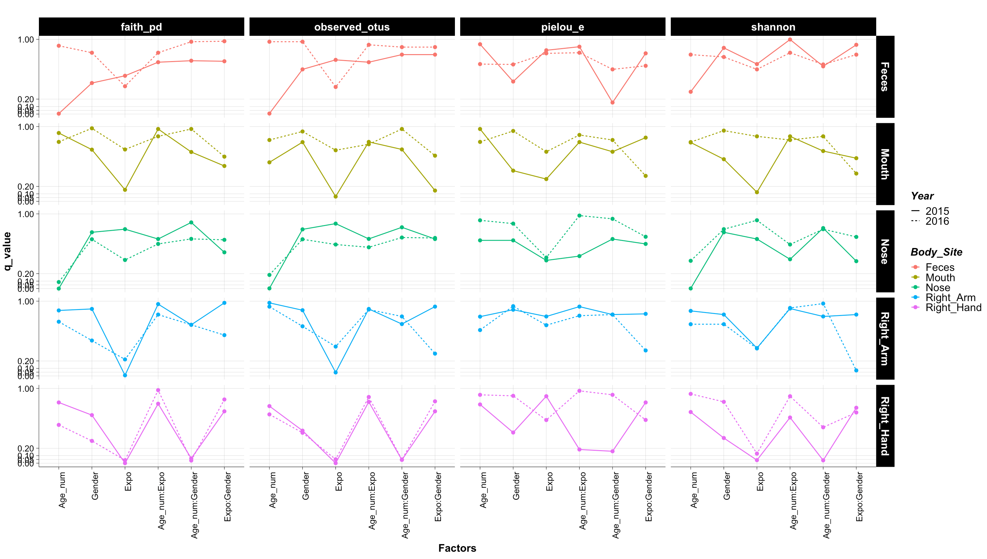
FDR corrected p-value using a full multiple regression models for alpha diversity in CHILDREN
Interaction terms generally are not significant except for Right Hand, in which age:gender interactions seems to be consistent.
Expo are generally significant.

Slide 4
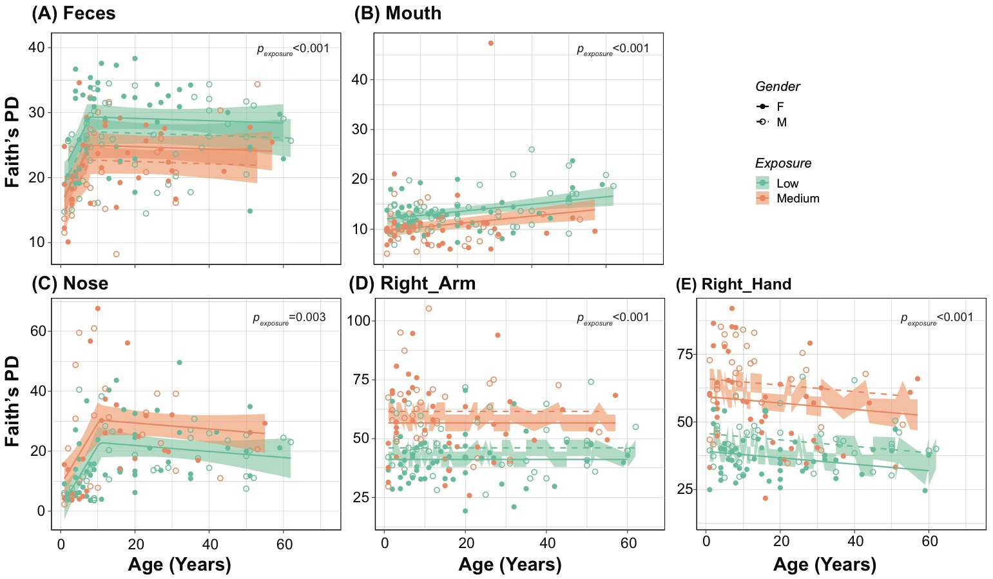
Figure 1 Microbiota alpha diversity from Amerindian villagers from low and medium medical exposure in 2015. (A) Feces, (B) Mouth, (C) Nose, (D) Right Arm, (E) Right Hand. Infants younger than 1 yr were not included. Impacts of level of medical exposure, gender, age and their interactions on the alpha diversity indexes were examined by firstly constructing multiple regression models with a forward selection using AIC as model selection criteria (MASS package stepAIC). Selected multiple regression model predictors were then used to construct a broken stick regression model using urban, age, and gender as predictive variable (segmented package) if the broken stick model is significantly better than simple linear regression. The numbers in each panel indicate the p-values of exposure after multiple linear regression. There was a significant effect of age in all body sites but right arm, and of gender in fecal and skin (right arm and right hand) microbiota. See table Sx for details.
Exposure level significantly impacted the the alpha diversity (Faith’s PD). Exposure level has the strongest effect comparing to other factors (judged by coefficient estimate and t-value).
Age is a significant factor in all body sites but right arm, and the direction and pattern of its impact vary by different body sites.
Gender is a significant factor except in mouth and nose.
In fecal and oral community, medical exposure resulting in less alpha diversity, however, in nasal and skin community, medical exposure was associated with much higher alpha diversity.
Notes:
among Sanema villages nasal and skin community differend by village.
Diversity in kanarakuni was for fecal and oral and highest for nasal and skin (Duncan’s test p<0.05)

Slide 5
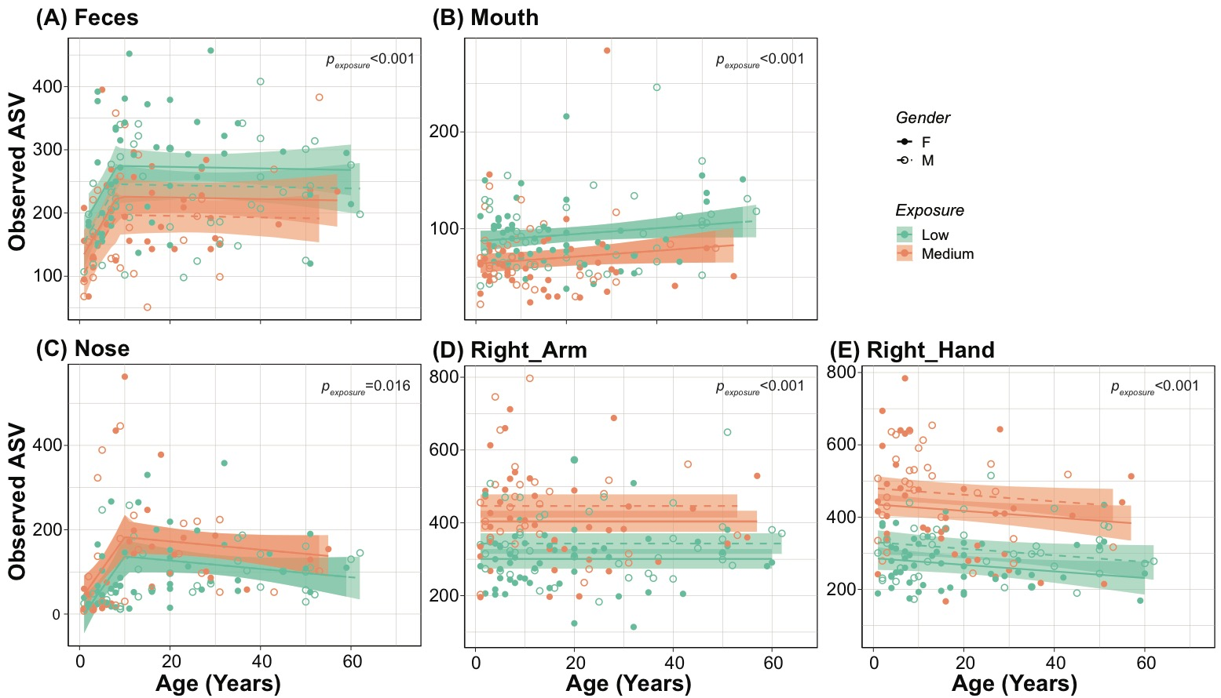
Figure S1 Microbiota alpha diversity from Amerindian villagers from low and medium urban exposure in 2015. (A) Feces, (B) Mouth, (C) Nose, (D) Right Arm, (E) Right Hand. Infants younger than 1 yr were not included. Impacts of level of medical exposure, gender, age and their interactions on the alpha diversity indexes were examined by firstly constructing multiple Infants younger than 1 yr were not included. Impacts of urban level, gender, age and their interactions on the alpha diversity indexes were examined by firstly constructing multiple regression models with a forward selection using AIC as model selection criteria (MASS package stepAIC). Selected multiple regression model predictors were then used to construct a broken stick regression model using urban, age, and gender as predictive variable (segmented package) if the broken stick model is significantly better than simple linear regression. The numbers in each panel indicate the p-values of exposure after multiple linear regression. There was a significant effect of age in fecal microbiota, and of gender in fecal and skin (right arm and right hand) microbiota. See table Sx for details.
Similar trends as in Faith’s PD
The medium exposure village have 100-150 more ASVs in skin as compared to low exposure villages.
In feces, medium villages have 50.ASV less than low villages

Slide 6
Table S1. Statistics for multiple linear regression to effects or exposure, age, and gender on alpha diversities in multiple body sites. P-value <0.05 was highlighted.
Factor | Body_Sites | Year | Faith_PD |  |  | Observed_ASV |  |  | Shannon
 |  |  | Estimate | t value | Pr(>|t|) | Estimate | t value | Pr(>|t|) | Estimate | t value | Pr(>|t|)
Exposure (Ref: Low) | Feces | 2015 | -4.715 | -4.794 | 0.000 | -52.096 | -3.995 | 0.000 | -0.400 | -2.957 | 0.004
 |  | 2016 | -3.493 | -4.006 | 0.000 | -30.235 | -3.132 | 0.002 | -0.440 | -3.694 | 0.000
 | Mouth | 2015 | -2.385 | -3.451 | 0.001 | -23.322 | -3.929 | 0.000 | -0.881 | -6.449 | 0.000
 |  | 2016 | -2.236 | -3.239 | 0.001 | -17.705 | -2.645 | 0.009 | -0.053 | -0.321 | 0.748
 | Nose | 2015 | 7.200 | 3.063 | 0.003 | 43.186 | 2.444 | 0.016 | 0.023 | 0.105 | 0.917
 |  | 2016 | 4.048 | 2.108 | 0.037 | 17.844 | 1.352 | 0.179 | -0.029 | -0.139 | 0.889
 | Right_Arm | 2015 | 15.487 | 7.254 | 0.000 | 102.915 | 5.868 | 0.000 | 0.418 | 3.379 | 0.001
 |  | 2016 | 8.574 | 2.543 | 0.013 | 56.245 | 1.816 | 0.073 | 0.600 | 3.584 | 0.001
 | Right_Hand | 2015 | 20.249 | 10.688 | 0.000 | 149.137 | 9.296 | 0.000 | 0.665 | 6.002 | 0.000
 |  | 2016 | 16.518 | 6.007 | 0.000 | 135.026 | 5.253 | 0.000 | 0.666 | 3.343 | 0.001
Age | Feces | 2015 | 0.066 | 2.170 | 0.032 | 0.884 | 2.199 | 0.029 | 0.003 | 0.822 | 0.413
 |  | 2016 | 0.032 | 1.326 | 0.186 | 0.190 | 0.708 | 0.480 | 0.001 | 0.438 | 0.662
 | Mouth | 2015 | 0.075 | 3.437 | 0.001 | 0.337 | 1.800 | 0.074 | 0.000 | 0.015 | 0.988
 |  | 2016 | 0.115 | 5.588 | 0.000 | 0.820 | 4.116 | 0.000 | 0.009 | 1.881 | 0.062
 | Nose | 2015 | 0.185 | 2.643 | 0.009 | 0.976 | 1.856 | 0.066 | 0.018 | 2.761 | 0.007
 |  | 2016 | 0.176 | 3.108 | 0.002 | 0.962 | 2.476 | 0.015 | 0.015 | 2.449 | 0.016
 | Right_Arm | 2015 | -0.005 | -0.082 | 0.935 | -0.059 | -0.111 | 0.911 | -0.001 | -0.182 | 0.856
 |  | 2016 | -0.072 | -0.660 | 0.511 | -0.555 | -0.552 | 0.583 | -0.009 | -1.644 | 0.104
 | Right_Hand | 2015 | -0.119 | -2.039 | 0.043 | -0.912 | -1.849 | 0.066 | -0.008 | -2.210 | 0.028
 |  | 2016 | -0.136 | -1.580 | 0.117 | -1.330 | -1.651 | 0.102 | -0.016 | -2.522 | 0.013
Gender (Ref: F) | Feces | 2015 | -2.341 | -2.435 | 0.016 | -29.899 | -2.345 | 0.020 | -0.261 | -1.978 | 0.050
 |  | 2016 | -1.201 | -1.479 | 0.141 | -8.577 | -0.954 | 0.342 | -0.065 | -0.589 | 0.557
 | Mouth | 2015 | -0.039 | -0.058 | 0.954 | 0.111 | 0.019 | 0.985 | -0.132 | -0.991 | 0.323
 |  | 2016 | 0.162 | 0.232 | 0.817 | -2.367 | -0.350 | 0.727 | 0.058 | 0.350 | 0.727
 | Nose | 2015 | -0.629 | -0.276 | 0.783 | -9.163 | -0.534 | 0.594 | -0.168 | -0.774 | 0.441
 |  | 2016 | -1.440 | -0.761 | 0.448 | -10.553 | -0.811 | 0.419 | -0.159 | -0.779 | 0.437
 | Right_Arm | 2015 | 4.926 | 2.350 | 0.020 | 42.255 | 2.454 | 0.015 | 0.365 | 3.007 | 0.003
 |  | 2016 | 1.547 | 0.445 | 0.657 | 13.669 | 0.428 | 0.670 | -0.050 | -0.288 | 0.774
 | Right_Hand | 2015 | 6.619 | 3.529 | 0.001 | 44.567 | 2.806 | 0.006 | 0.252 | 2.294 | 0.023
 |  | 2016 | 5.432 | 1.925 | 0.057 | 50.573 | 1.917 | 0.058 | 0.307 | 1.501 | 0.136
Urban have been shown to significantly impact the alpha diversity for nearly all three indexes for all body sites, in both years, except for the Shannon index for the nasal microbiome.
In fecal and oral microbiota, more exposure resulting in less alpha diversity, however, in nasal and skin microbiota, more exposure was associated with higher alpha diversity.
In skin, more urban was associated with as much as 149 more ASV.
Increasing age has associated with increasing alpha diversity in fecal, oral and nasal community but decreased alpha diversity in skin community.
Gender difference is not a strong factor determining the alpha diversity

Slide 7
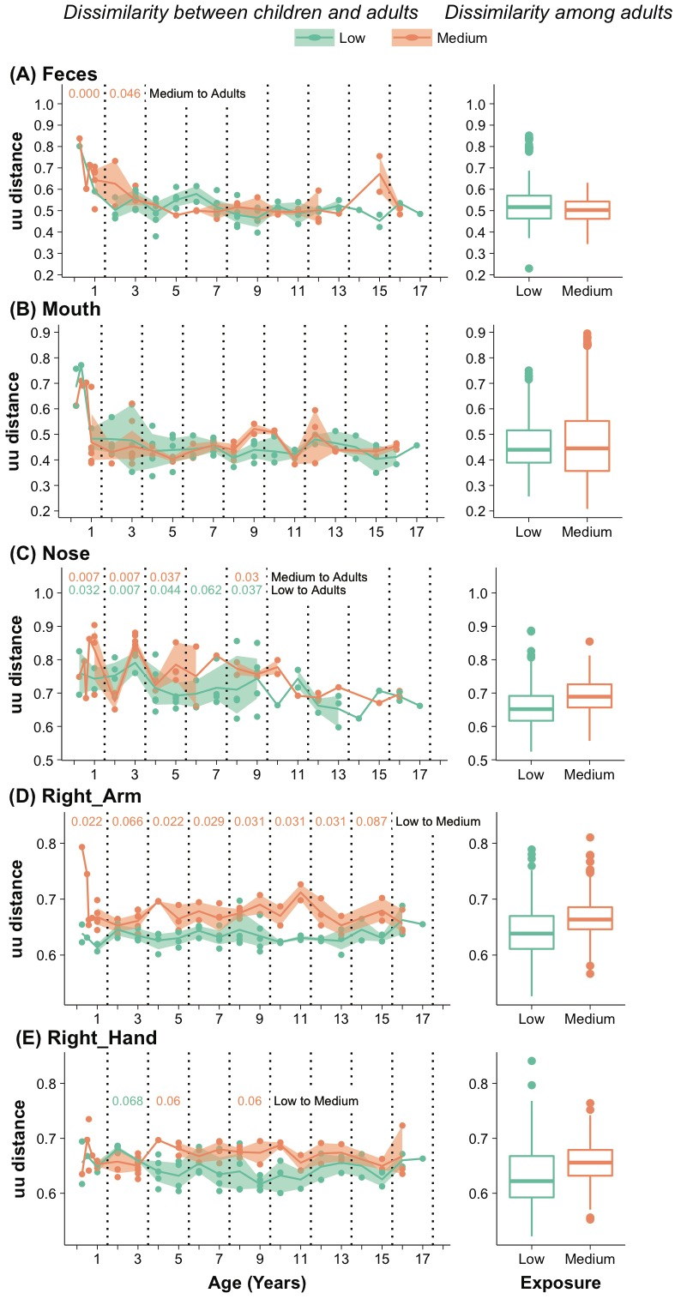
Figure S2. Dissimilarities of child-to-adult microbiota across different ages (left panels) compared with among-adult dissimilarities (right panels in 2015, stratified by exposure level. Each point on the left panels represents the average of unweighted unifrac distance between a child and all the adults in the same villages, with mean and 95% confidence interval plotted by exposure level. Kruskal-wallis tests were performed by pooling data from age 0-1, 2-3, 4-5, …, 16-17, to compare (1) child-to-adults dissimilarities between low and medium exposure level (Low to Medium) at each age interval; (2) children-to-adult dissimilarities to among-adult dissimilarities in low exposure villages (Low to Adults) at each age interval; (3) children-to-adult dissimilarities to among-adult dissimilarities in medium exposure villages (Medium to Adults) at each age interval. Multiple correction based on FDR was performed and a corrected p-value lower than 0.1 was deemed as significant and plotted on the graphs. The p-value was colored according to different exposure level with higher mean.
A decreasing trend of dissimilarities to adults with increasing age was only observed in the nasal microbiota, not in other body sites.
The dissimilarities to adults was higher for the medium than for the low exposure villagers in the skin, significant only for the right arm. They remain less adult-like, or immature.

Slide 8
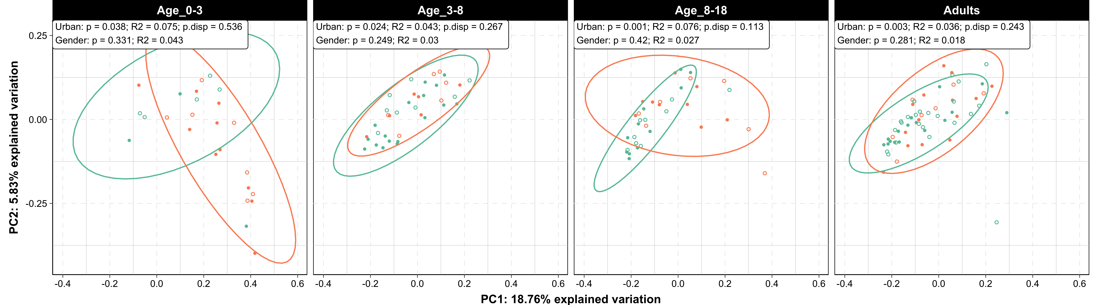
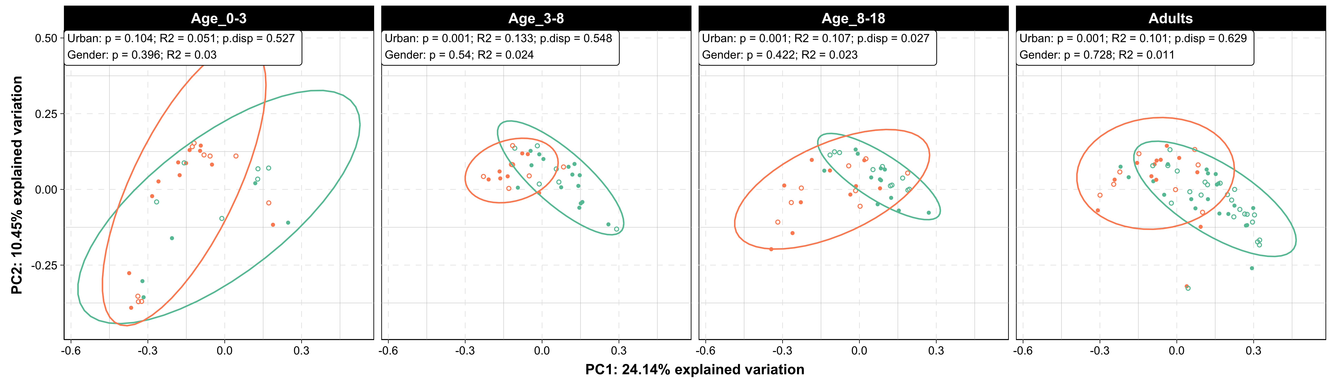
Figure 2 Beta diversity differences in 16S microbial communities in villages with low and high medical exposure in 2015 measured by unweighted unifrac distance. (A) Feces, (B) Mouth, (C) Nose, (D) Right Arm, (E) Right Hand. In the top left window of each panel, Adonis p-value, and R2 on the marginal effect of medical exposure levels and gender, p-value of the Permutation tests on beta dispersion. Further statistics were presented in table Sx.
(A) Feces
(B) Mouth
Medical exposure consistently affects microbiota structure in nearly all ages and at all sites.
Data variation does not explain these exposure segregation (Permutation tests on beta dispersion showed not significant differences).
The effect of medical exposure was stronger in children than in adults, as indicated by the Adonis tests R2 values which are higher in children (higher effect sizes of urban exposure are higher in children).

Slide 9
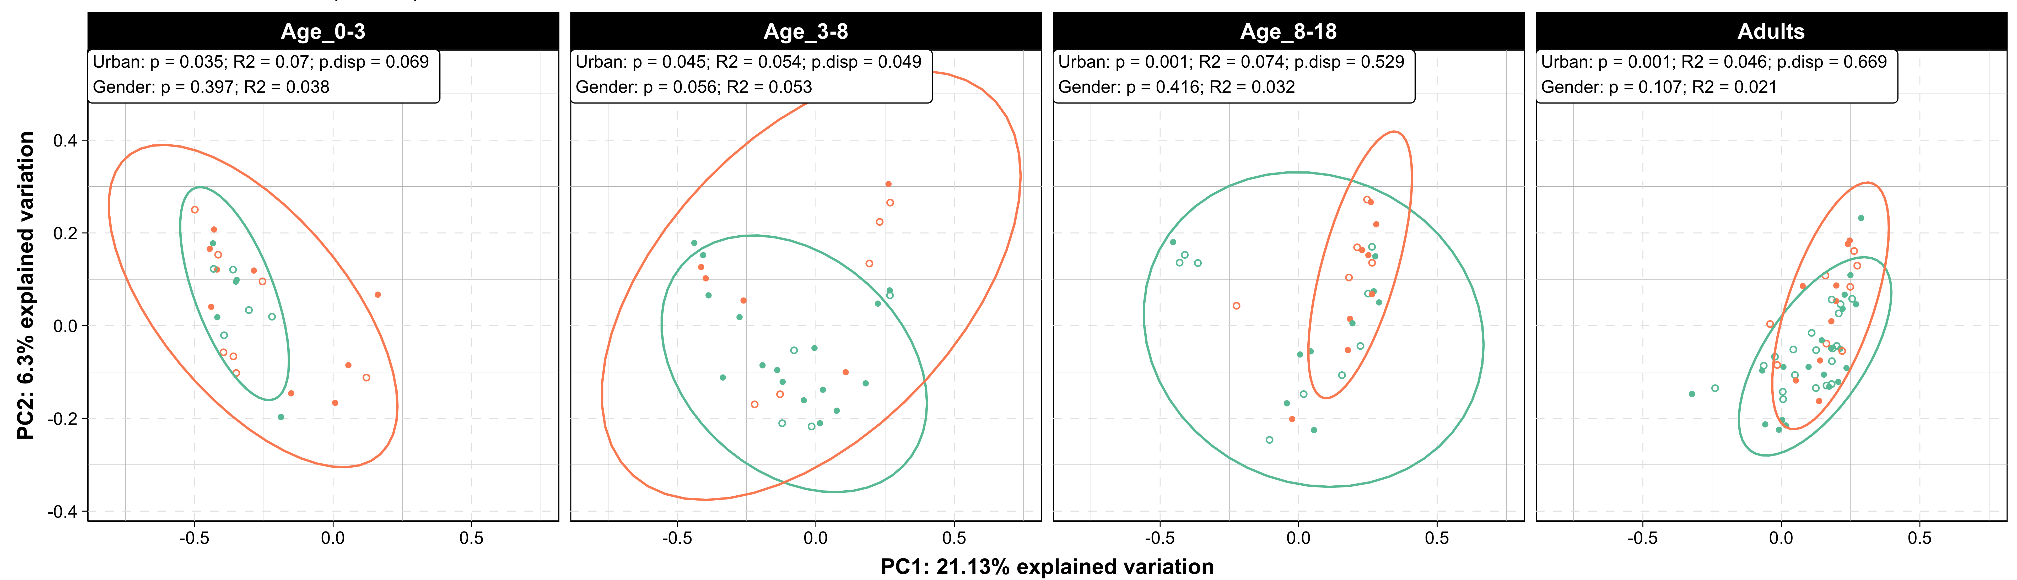
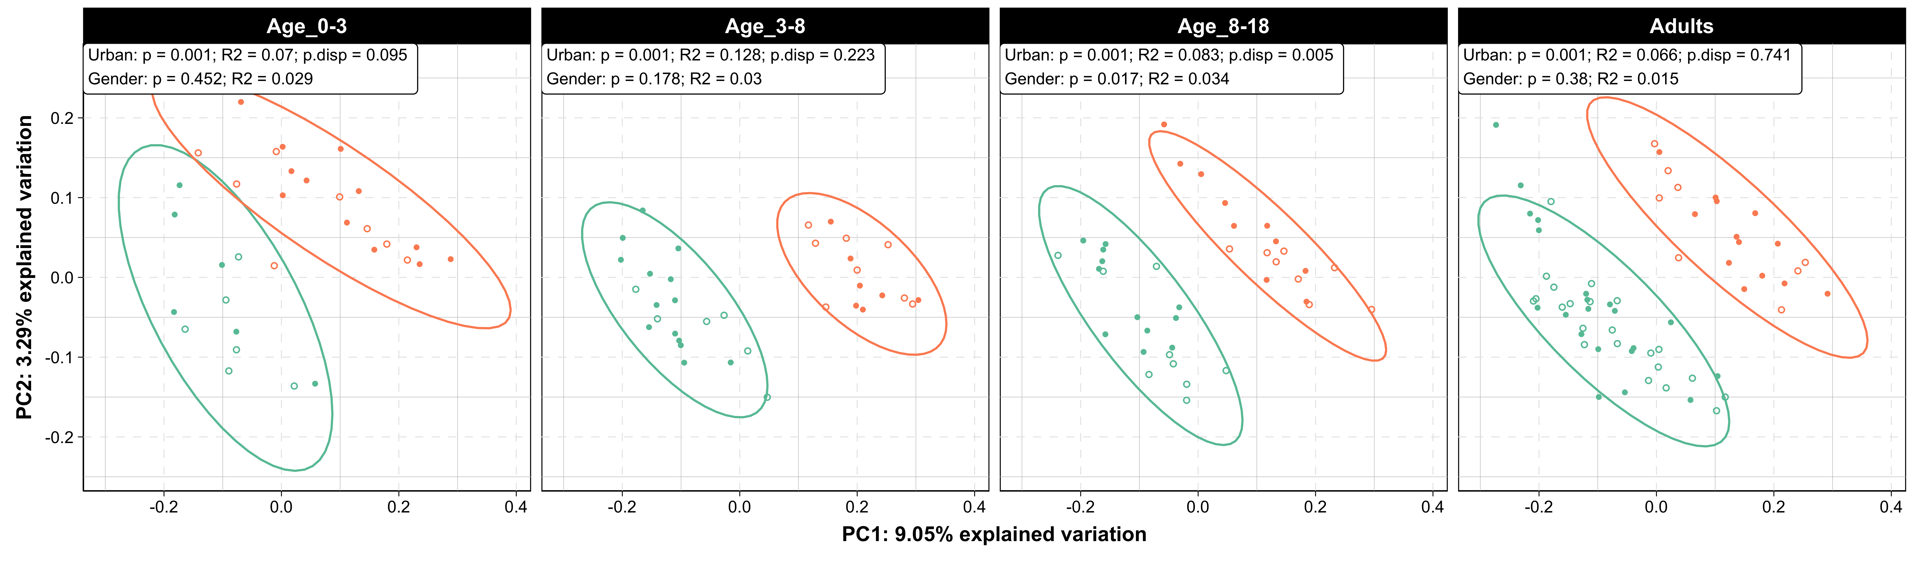
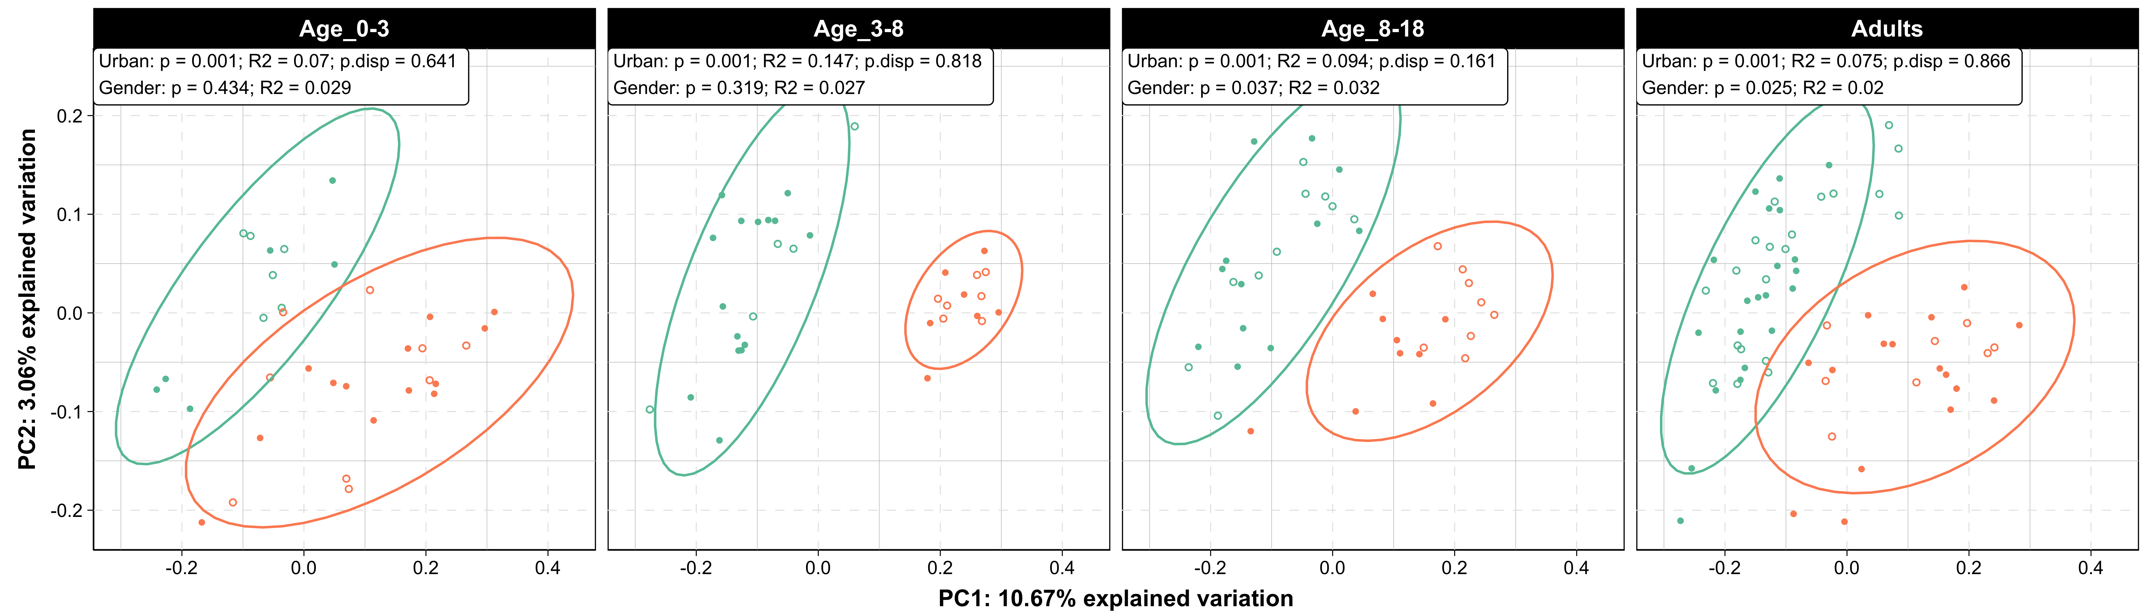
(C) Nose
(D) Right Arm
(E) Right Hand

Slide 10
Table S2. Statistics for permanova test on marginal effect of urban and gender in separate age groups or across all age in each body sites in 2015. adonis2 function from vegan package was used to generate the statistics. P-value <0.05 was highlighted.
Body_Site | Factor | Age_0-3 |  |  | Age_3-8 |  |  | Age_8-18 |  |  | Adults |  |  | All Age
 |  | R2 | F | Pr(>F) | R2 | F | Pr(>F) | R2 | F | Pr(>F) | R2 | F | Pr(>F) | R2 | F | Pr(>F)
Feces | Exposure | 7.5% | 1.87 | 0.026 | 4.3% | 1.56 | 0.026 | 8.2% | 2.94 | 0.002 | 3.5% | 2.13 | 0.004 | 3.8% | 6.24 | 0.001
 | Gender | 4.3% | 1.07 | 0.304 | 3.0% | 1.10 | 0.244 | 2.6% | 0.94 | 0.518 | 1.7% | 1.05 | 0.326 | 0.9% | 1.42 | 0.073
 | Age |  |  |  |  |  |  |  |  |  |  |  |  | 1.7% | 2.86 | 0.001
Mouth | Exposure | 5.1% | 1.62 | 0.12 | 13.3% | 5.05 | 0.001 | 9.5% | 3.87 | 0.001 | 10.6% | 7.47 | 0.001 | 8.7% | 16.51 | 0.001
 | Gender | 3.0% | 0.96 | 0.408 | 2.4% | 0.91 | 0.547 | 2.3% | 0.96 | 0.442 | 1.1% | 0.79 | 0.646 | 0.4% | 0.81 | 0.659
 | Age |  |  |  |  |  |  |  |  |  |  |  |  | 3.2% | 6.13 | 0.001
Nose | Exposure | 7.0% | 1.81 | 0.038 | 5.4% | 1.64 | 0.063 | 6.9% | 2.09 | 0.008 | 4.9% | 2.85 | 0.001 | 2.7% | 4.08 | 0.001
 | Gender | 3.8% | 0.99 | 0.421 | 5.3% | 1.59 | 0.048 | 3.2% | 0.95 | 0.431 | 2.1% | 1.21 | 0.12 | 0.7% | 1.00 | 0.361
 | Age |  |  |  |  |  |  |  |  |  |  |  |  | 5.6% | 8.57 | 0.001
Right_Arm | Exposure | 7.0% | 2.35 | 0.001 | 12.8% | 4.87 | 0.001 | 8.5% | 3.39 | 0.001 | 6.5% | 4.46 | 0.001 | 6.2% | 11.34 | 0.001
 | Gender | 2.9% | 0.98 | 0.464 | 3.0% | 1.13 | 0.173 | 3.3% | 1.32 | 0.025 | 1.5% | 1.02 | 0.352 | 0.8% | 1.45 | 0.011
 | Age |  |  |  |  |  |  |  |  |  |  |  |  | 0.6% | 1.02 | 0.332
Right_Hand | Exposure | 7.0% | 2.39 | 0.003 | 14.7% | 5.51 | 0.001 | 9.6% | 3.87 | 0.001 | 7.5% | 5.20 | 0.001 | 7.4% | 13.59 | 0.001
 | Gender | 2.9% | 0.99 | 0.392 | 2.7% | 1.02 | 0.315 | 3.2% | 1.28 | 0.055 | 2.0% | 1.40 | 0.027 | 0.9% | 1.66 | 0.008
 | Age |  |  |  |  |  |  |  |  |  |  |  |  | 0.8% | 1.57 | 0.012
Medical exposure is consistently significant in all age groups in all body sites.
The effect size medical exposure, was stronger than that age, and gender in all body sites except in nose. The effect sizes of age in nasal communities is larger than that of medical exposure.

Slide 11
Fig 3. Relative Abundance of genera that are significantly different by medical exposure. (A) Feces, (B) Mouth, (C) Nose, (D) Right Arm, (E) Right Hand. Genera were identified by ANCOM log-ratio test; Ancom W statistics is presented as a side bar. The predicted log-ratio between medium and low exposure group of a significant changed genus were also presented as a side bar with positive values indicating higher in medium exposure group. Genera in the row are ordered by hierarchy clustering based on relative abundance in samples. ((Fig Sx with LEFSE ROSETA. Taxa aligned to legt margin for the heatmap) SEPARATE DISSAPEARING FROM INCREASING TAXA TREES
(A) Feces
Of 194 genera were identified from fecal microbiota in villagers in 2015; 20 genera were significantly different by exposure.
Changes based on references of the three families that are abundant and did not change in this work, Prevotellaceae, Succinivibrionaceae, and Spirochaetaceae
DECREASING TAXA: several Clostidiales (Lachnospiraceae, Ruminococcaceae), Mollicutes.RF39 genus, Dialister, Erysipelotrichaceae-UCG004 genus, Methanobrevibacter
INCREASING: Bacteroides, Parabacteroides, Haemophilus, Enterobacteriaceae, Odoribacter.
DISCUSSION: Prevotellaceae, Succinivibrionaceae, and Spirochaetaceae, which were previously suggested to be more abundant in Hadza populations (Smits 2017), were among the species that did not change with urban exposure; these species on average constitute of 31.5%(SD=20.3%), 8.25%(SD=12.4%) , 4.54%(SD=8.11%) of total abundance, respectively for Prevotellaceae, Succinivibrionaceae, and Spirochaetaceae.

Slide 12
(B) Mouth
A total of 78 genera were identified from oral microbiota in villagers in 2015; 15 genera were significantly different.
Decreasing taxa: Fusobacterium, Campylobacter, Cornybacterium, Lachnoanaerobaculum, Tannerrella, Treponema, and several Prevotella
Increasing taxa: Bergeyella slightly increased in medium exposure.
Discussion: Haemophilus and Neisseria, which were previously suggested to be part of core oral microbiome (Li 2014), were among the species that did not change with urban exposure; these species on average constitute of 13.2%(SD=9.3%), 9.1%(SD=7.7%) of total abundance
Notes:
Li, J., Quinque, D., Horz, H., Li, M., Rzhetskaya, M., Raff, J., Hayes, M., Stoneking, M. (2014). Comparative analysis of the human saliva microbiome from different climate zones: Alaska, Germany, and Africa BMC Microbiology 14(1), 316. https://dx.doi.org/10.1186/s12866-014-0316-1

Slide 13
(C) Nose
A total of 195 genera were identified from nasal microbiota in villagers in 2015; 18 genera were significantly different
Decreasing taxa: genera from families Leuconostocaceae, several Actinobacteria genus including Cornybacterium.1, Moraxella, Dolosigranulum
Increasing taxa: Rothia, Roseomonas, Halococcus, Flavisolibacter, Janibacter, a Pseudonocardiaceae genus.
Discussion: Among those genus common appeared in healthy human nasal microbiome (Kumpitsch 2019), Staphylococcus, Streptococcus did not change and constitute a significant portion of total abundance; these species on average constitute of 6.1%(SD=10.4%), 10.3%(SD=14.3%) of total abundance.
Notes:
Kumpitsch, C., Koskinen, K., Schöpf, V., Moissl-Eichinger, C. (2019). The microbiome of the upper respiratory tract in health and disease BMC Biology 17(1), 87. https://dx.doi.org/10.1186/s12915-019-0703-z

Slide 14
(D) Right Arm
A total of 518 genera were identified from right arm microbiota in villagers in 2015; 53 genus were significantly different
Decreasing taxa: mainly genera from Actinobacteria
Increasing taxa: many Actinobacteria genera, and several Oxyphotobacteria genera.
Notes:
Kumpitsch, C., Koskinen, K., Schöpf, V., Moissl-Eichinger, C. (2019). The microbiome of the upper respiratory tract in health and disease BMC Biology 17(1), 87. https://dx.doi.org/10.1186/s12915-019-0703-z

Slide 15
(E) Right Hand
A total of 503 genera were identified from right hand microbiota in villagers in 2015; 87 genus were significantly different
Notes:
Kumpitsch, C., Koskinen, K., Schöpf, V., Moissl-Eichinger, C. (2019). The microbiome of the upper respiratory tract in health and disease BMC Biology 17(1), 87. https://dx.doi.org/10.1186/s12915-019-0703-z

Slide 16
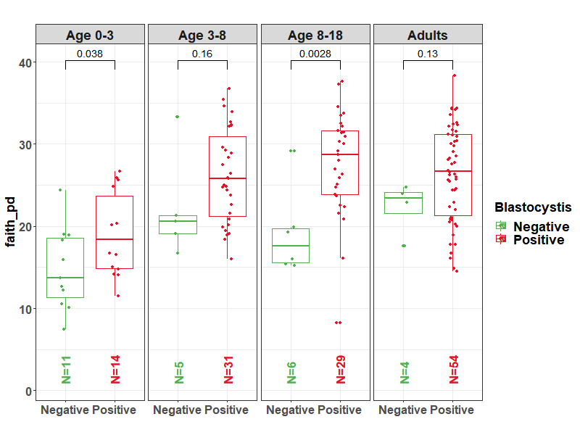
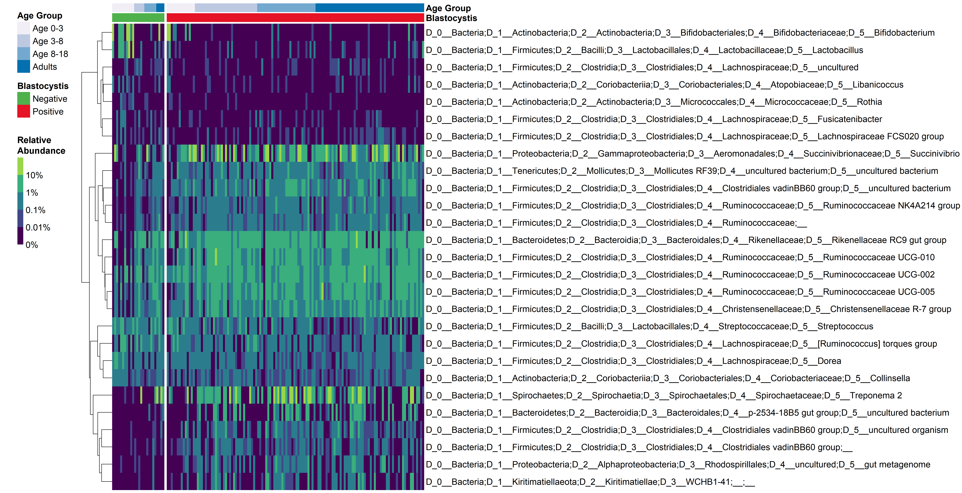
Fig 4. (A)Alpha diversity of fecal microbiota by Blastocystis status and age group. (B) Relative abundance of fecal bacteria that significantly differ by Blastocistis status
A
Alpha diversity tends to be higher in Blastocystis positive subjects, significant in the 0-3 and 8-18y age groups
B
Phylum | Order | Family | Genus | log2Ratio (Positive/Negative)
Actinobacteria | Bifidobacteriales | Bifidobacteriaceae | Bifidobacterium | -4.10
Firmicutes | Lactobacillales | Lactobacillaceae | Lactobacillus | -4.55
Firmicutes | Clostridiales | Lachnospiraceae | uncultured | -1.29
Actinobacteria | Coriobacteriales | Atopobiaceae | Libanicoccus | -1.91
Actinobacteria | Micrococcales | Micrococcaceae | Rothia | -3.35
Firmicutes | Clostridiales | Lachnospiraceae | Fusicatenibacter | -2.34
Firmicutes | Clostridiales | Lachnospiraceae | Lachnospiraceae FCS020 group | -1.71
Proteobacteria | Aeromonadales | Succinivibrionaceae | Succinivibrio | 1.64
Tenericutes | Mollicutes RF39 | uncultured bacterium | uncultured bacterium | 1.42
Firmicutes | Clostridiales | Clostridiales vadinBB60 group | uncultured bacterium | 2.14
Firmicutes | Clostridiales | Ruminococcaceae | Ruminococcaceae NK4A214 group | 2.31
Firmicutes | Clostridiales | Ruminococcaceae |  | 1.00
Bacteroidetes | Bacteroidales | Rikenellaceae | Rikenellaceae RC9 gut group | 0.97
Firmicutes | Clostridiales | Ruminococcaceae | Ruminococcaceae UCG-010 | 1.77
Firmicutes | Clostridiales | Ruminococcaceae | Ruminococcaceae UCG-002 | 0.85
Firmicutes | Clostridiales | Ruminococcaceae | Ruminococcaceae UCG-005 | 1.48
Firmicutes | Clostridiales | Christensenellaceae | Christensenellaceae R-7 group | 1.46
Firmicutes | Lactobacillales | Streptococcaceae | Streptococcus | -0.91
Firmicutes | Clostridiales | Lachnospiraceae | [Ruminococcus] torques group | -1.33
Firmicutes | Clostridiales | Lachnospiraceae | Dorea | -1.28
Actinobacteria | Coriobacteriales | Coriobacteriaceae | Collinsella | -0.84
Spirochaetes | Spirochaetales | Spirochaetaceae | Treponema 2 | 0.64
Bacteroidetes | Bacteroidales | p-2534-18B5 gut group | uncultured bacterium | 5.48
Firmicutes | Clostridiales | Clostridiales vadinBB60 group | uncultured organism | 4.16
Firmicutes | Clostridiales | Clostridiales vadinBB60 group |  | 3.85
Proteobacteria | Rhodospirillales | uncultured | gut metagenome | 4.19
Kiritimatiellaeota | WCHB1-41 |  |  | 4.15
Heatmap of relative abundance of the 27 taxa differing significantly with Blastocystis status. Each row represent a genus, each column represent a sample. Genus clustering was based on Euclidean distance using hclust (complete agglomeration method). Samples are arranged by Blastocystis status and age group. Font colors indicate higher (red) or lower (green) relative abundance in Blastocystis positive samples.

Slide 17
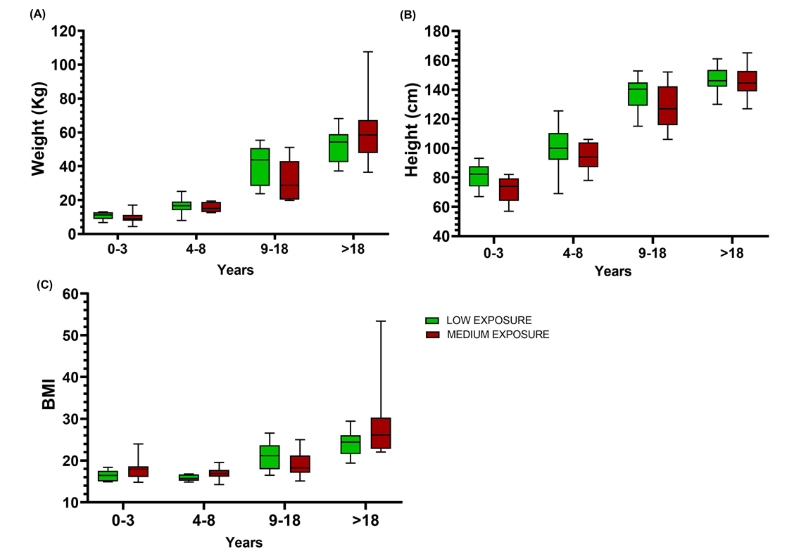
Figure x. Body morphometry from different exposure level during 2016.
Separate by gender!
BODY WEIGHT | N males | N females | Adjusted P Value
LOW - MEDIUM |  |  | males/females
0-3 |  | ns | 0.8595
4-8 |  | ns | 0.9798
9-18 |  | ns | 0.2540
>18 |  | ns | 0.3488
position=position_dodge(width=0.75)
HEIGHT | N | Summary | Adjusted P Value
LOW - MEDIUM
0-3 |  | ns | 0.2785
4-8 |  | ns | 0.5442
9-18 |  | ns | 0.1914
>18 |  | ns | 0.9887
BMI | N | Summary | Adjusted P Value
LOW - MEDIUM
0-3 |  | ns | 0.5376
4-8 |  | ns | 0.1299
9-18 |  | ns | 0.4774
>18 |  | ns | 0.1963
No significant difference in body morphometry was found in different exposure level.

Slide 18
Fig. 5A: Bray-Curtis distance for KEGG ortholog assignments – Amerindians exposure to Western medicine 2015
Permanova:
p = 0.001
Permanova:
p = 0.005

Slide 19
Fig 5A. Bray-Curtis distance for KEGG ortholog assignments – Amerindians exposure to Western medicine in 2016
Permanova:
p = 0.35
Permanova:
p = 0.96

Slide 20
Fig. 5B: Bray-Curtis distance for KEGG ortholog assignments – Amerindians compared to Western microbiomes 2015
Permanova:
p = 0.001
Permanova:
p = 0.001
Notes:
Batch effects
Differences with western is biger than our batch effect

Slide 21
Fig 5B. Bray-Curtis distance for KEGG ortholog assignments – Amerindians compared to Western microbiomes in 2016
Permanova:
p = 0.001
Permanova:
p = 0.001

Slide 22
Fig 5C.2015
Higher values =
greater
abundance
in
Western

Slide 23
Fig 5C.2016

Slide 24
Higher values =
greater
abundance
in
MediumUrban

Slide 25
Fig5D. - Beta-lactam KEGG ortholog abundance changes 2015

Slide 26
Fig5D. - Beta-lactam KEGG ortholog abundance changes in 2016

Slide 27
Parasite burden by village, 2015
Parasite Type | Chajuranha |  | Kanarakuni |  | Mosenahanha
 | N | n (%) | N | n (%) | N | n (%)
Onchocerca | 0 | - | 0 | - | 0 | -
Ancylostomide eggs | 25 | 12 (48.0) | 57 | 17 (29.8) | 6 | 3 (50.0)
Ascaris lumbricoides eggs | 25 | 10 (40.0) | 57 | 19 (33.3) | 6 | 0 (0)
Trichuris trichiura eggs | 25 | 1 (4.0) | 57 | 0 (0) | 6 | 0 (0)
Giardia lamblia cysts | 25 | 2 (8.0) | 57 | 8 (14.0) | 6 | 0 (0)
Giardia lamblia trofozoites | 27 | 1 (3.7) | 56 | 0 (0) | 6 | 0 (0)
Blastocystis spp. | 25 | 3 (12.0) | 57 | 11 (19.3) | 6 | 0 (0)
Iodamoeba butschlii cysts | 25 | 3 (12.0) | 57 | 2 (3.5) | 6 | 2 (33.3)
Endolimax nana cysts | 25 | 10 (40.0) | 57 | 25 (43.9) | 6 | 2 (33.3)
Entamoeba histolytica/dispar | 25 | 6 (24.0) | 57 | 11 (19.3) | 6 | 2 (33.3)
Entamoeba histolytica trofozoites | 25 | 14 (56.0) | 57 | 19 (33.3) | 6 | 3 (50.0)
Entamoeba coli cysts | 27 | 0 (0) | 57 | 2 (3.5) | 6 | 0 (0)
Entamoeba coli trofozoites | 27 | 0 (0) | 57 | 1 (1.8) | 6 | 0 (0)
Chilomastix mesnili cysts | 25 | 3 (12.0) | 57 | 19 (33.3) | 6 | 1 (16.7)
Enterobius vermicularis eggs | 27 | 0 (0) | 57 | 0 (0) | 6 | 0 (0)
Hymenolepis nana eggs | 27 | 0 (0) | 57 | 3 (5.3) | 6 | 0 (0)
Dientamoeba fragilis cyst | 27 | 0 (0) | 57 | 0 (0) | 6 | 0 (0)
Strongyloides stercolaris larvas | 27 | 0 (0) | 57 | 0 (0) | 6 | 0 (0)

Slide 28
Parasite burden by village, 2016
Parasite Type | Chajuranha |  | Fiyakwanha |  | Kanarakuni |  | Kuyuwininha |  | Shianana |  | Sudukuma |  | Washudihanha
 | N | n (%) | N | n (%) | N | n (%) | N | n (%) | N | n (%) | N | n (%) | N | n (%)
Onchocerca | 0 | - | 0 | - | 0 | - | 32 | 25 (78.1) | 0 | - | 0 | - | 0 | -
Ancylostomide eggs | 10 | 4 (40.0) | 44 | 27 (61.4) | 44 | 15 (34.1) | 32 | 8 (25.0) | 19 | 8 (42.1) | 22 | 6 (27.3) | 3 | 1 (33.3)
Ascaris lumbricoides eggs | 10 | 7 (70.0) | 44 | 15 (34.1) | 44 | 17 (38.6) | 32 | 2 (6.3) | 19 | 16 (84.2) | 22 | 9 (40.9) | 3 | 2 (66.7)
Trichuris trichiura eggs | 10 | 1 (10.0) | 44 | 12 (27.3) | 44 | 0 (0) | 32 | 0 (0) | 19 | 6 (31.6) | 22 | 2 (9.1) | 3 | 0 (0)
Giardia lamblia cysts | 10 | 0 (0) | 44 | 1 (2.3) | 44 | 5 (11.4) | 32 | 6 (18.8) | 19 | 1 (5.3) | 22 | 3 (13.6) | 3 | 0 (0)
Giardia lamblia trofozoites | 10 | 1 (10.0) | 44 | 0 (0) | 43 | 0 (0) | 32 | 4 (12.5) | 19 | 0 (0) | 22 | 1 (4.5) | 3 | 0 (0)
Blastocystis spp. | 10 | 3 (30.0) | 44 | 5 (11.4) | 44 | 9 (20.5) | 32 | 9 (28.1) | 19 | 3 (15.8) | 22 | 5 (22.7) | 3 | 0 (0)
Iodamoeba butschlii cysts | 10 | 2 (20.0) | 44 | 1 (2.3) | 44 | 0 (0) | 32 | 3 (9.4) | 19 | 4 (21.1) | 22 | 5 (22.7) | 3 | 0 (0)
Endolimax nana cysts | 10 | 4 (40.0) | 44 | 12 (27.3) | 44 | 18 (40.9) | 32 | 0 (0) | 19 | 8 (42.1) | 22 | 15 (68.2) | 3 | 1 (33.3)
Entamoeba histolytica/dispar | 10 | 0 (0) | 44 | 1 (2.3) | 44 | 7 (15.9) | 32 | 13 (40.6) | 19 | 1 (5.3) | 22 | 5 (22.7) | 3 | 0 (0)
Entamoeba histolytica trofozoites | 10 | 9 (90.0) | 44 | 16 (36.4) | 44 | 16 (36.4) | 32 | 2 (6.3) | 19 | 11 (57.9) | 22 | 18 (81.8) | 3 | 0 (0)
Entamoeba coli cysts | 10 | 0 (0) | 44 | 0 (0) | 44 | 2 (4.5) | 32 | 0 (0) | 19 | 0 (0) | 22 | 1 (4.5) | 3 | 0 (0)
Entamoeba coli trofozoites | 10 | 0 (0) | 44 | 0 (0) | 44 | 1 (2.3) | 32 | 1 (3.1) | 19 | 1 (5.3) | 22 | 3 (13.6) | 3 | 0 (0)
Chilomastix mesnili cysts | 10 | 3 (30.0) | 44 | 4 (9.1) | 44 | 19 (43.2) | 32 | 1 (3.1) | 19 | 1 (5.3) | 22 | 9 (40.9) | 3 | 0 (0)
Enterobius vermicularis eggs | 10 | 0 (0) | 44 | 0 (0) | 44 | 0 (0) | 32 | 2 (6.3) | 19 | 0 (0) | 22 | 1 (4.5) | 3 | 0 (0)
Hymenolepis nana eggs | 10 | 0 (0) | 44 | 2 (4.5) | 44 | 3 (6.8) | 33 | 0 (0) | 19 | 0 (0) | 22 | 2 (9.1) | 3 | 0 (0)
Dientamoeba fragilis cyst | 10 | 0 (0) | 44 | 0 (0) | 44 | 0 (0) | 0 | - | 19 | 0 (0) | 22 | 0 (0) | 3 | 0 (0)
Strongyloides stercolaris larvas | 10 | 0 (0) | 44 | 0 (0) | 44 | 0 (0) | 0 | - | 19 | 0 (0) | 22 | 1 (4.5) | 3 | 0 (0)

